Slide 1
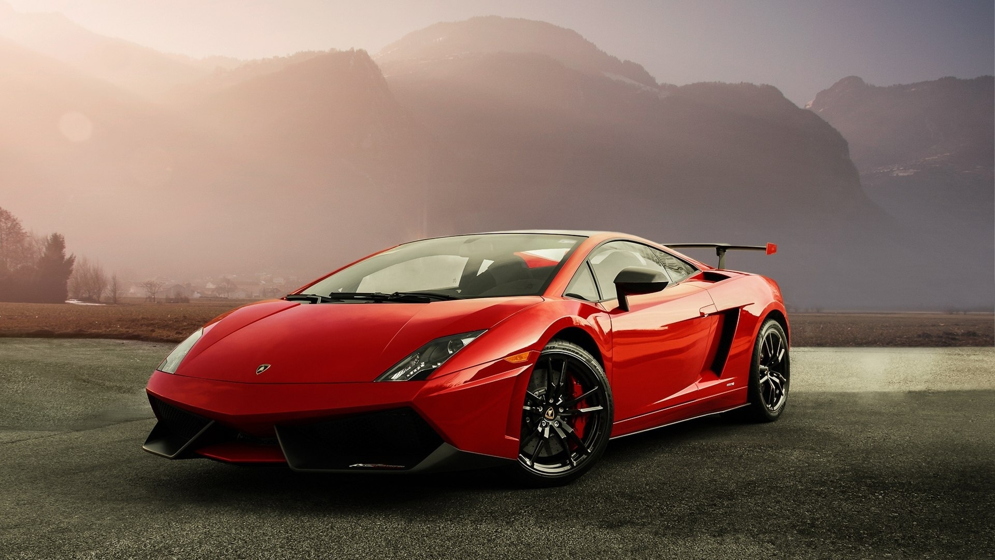
CAR DEKHO USEDCAR PRICE PREDICTION
BY
ARULSELVI

Slide 2

About Cardekho
Incorporated in 2006
Subsidiary of Girnar Automobiles Private Limited
Connects consumers, automobile dealers & OEM through web portals
Providing software services for consumers and automobile dealers
facilitates financing and insurance of automobiles
Group operating income was Approx. 2000 Cr during Fy 2023
Notes:
ICRA credit rating agency(oem=orginal equipment manufactor)

Slide 3
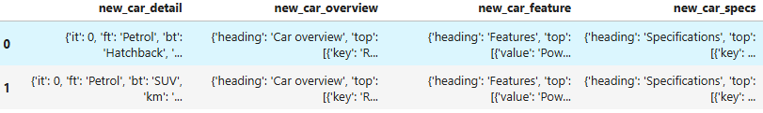
Data set description
The dataset which going to perform is in nested json format. Hence we need to convert them into flatten json in order to perform the data processing, EDA and model evaluation.
The flatten-json is a third-party library that transforms your complex data into a table. To use the flatten-JSON library, we must first install and import the package using the following code.
Flattening a dictionary refers to the process of converting a nested or hierarchical dictionary structure into a flat, one-dimensional form. In simpler terms.

Slide 4
TOOLS USED
Google_colab
Streamlit
Pandas
Numpy
Scikit-Learn
Plotly

Slide 5
Code execution
Import data from all excel files
Dictinary to flatten json converted
Check for missing values,null managed, outliers and data types
Data Preprocessing:
Handle Missing Values: Impute or remove missing values
Encode categorical variables using suitable techniques
Normalization/Scaling: Scale numerical features to bring them to a comparable range
Exploratory Data Analysis:
Create visualizations to understand the distribution of target variables
(used car prices) and relationships between features
Choose regression models suitable for predicting continuous values
Model Evaluation

Slide 6
Models vs R2 Score
MODEL | R2Score
Gradient boosting regression | 0.89
Extra tree regression | 0.88
XGBRegressor | 0.87
RandomForestRegressor | 0.87

Slide 7
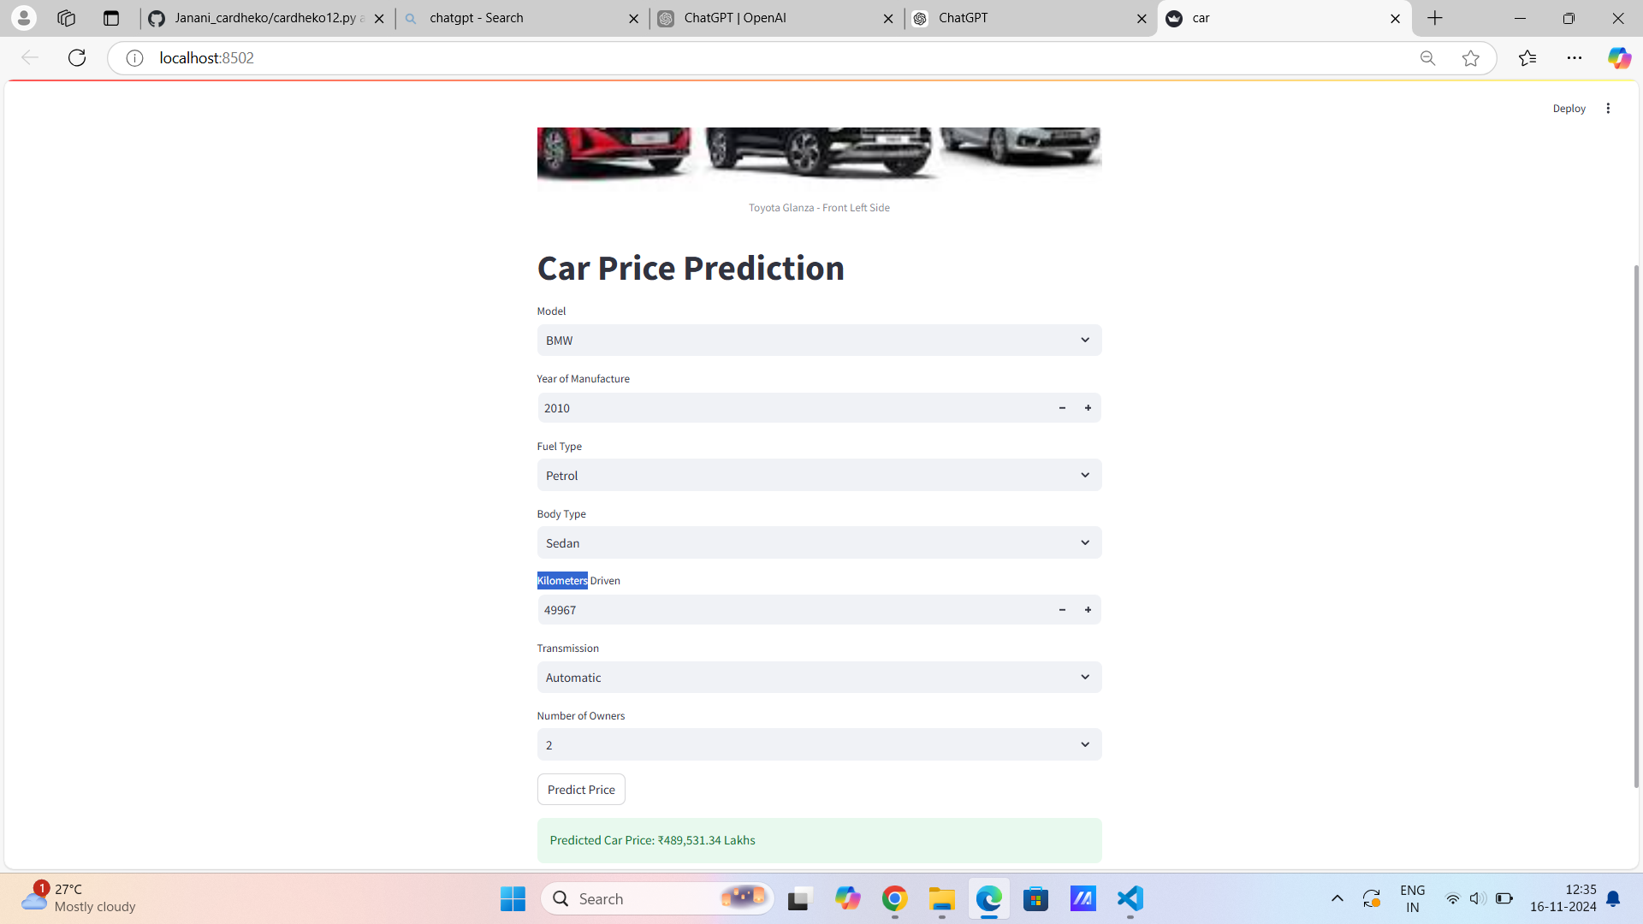
Conclusion
Coding executed through google colab
Exported file to streamlit in VS
Models performance evaluated & compared
R2 score of “Gradientboostingregression” model observed highest among all others
Concluding it as the best model for car price prediction

Slide 8
Thank you

